Slide 1
AI Training Material
Practical Session
December 05, 2025
FUJIFILM Business Innovation Asia Pacific
FBAP-ICT / Satya Veera Prasad M

Slide 2
Version History
Below table provides an overview of the different versions of this presentation, highlighting key updates, authorship, and dates.
Version | Date | Author | Description / Change Log
1.0 | 2025-10-21 | Satya Veera Prasad M | Initial draft
1.1 | 2025-11-03 | Satya Veera Prasad M | Added content – Use case of Fujifilm(Unstructured data)
1.2 | 2025-11-24 | Satya Veera Prasad M | Added content – Use case of Fujifilm(Transformer Architecture
1.3 | 2025-11-26 | Satya Veera Prasad M | Added content – Questions and Answers
1.4 | 2025-11-27 | Satya Veera Prasad M | Added content – Prompt Engineering

Slide 3
Objectives
Here are the objectives of the AI workshop/training.
Introduce fundamental AI concepts to build a strong foundational understanding.
Clarify essential AI terminology by explaining key concepts clearly, enabling participants to participate confidently in AI discussions.
Demonstrate practical AI applications using Fujifilm use cases wherever applicable.
Inspire the team to continue exploring AI capabilities and identify opportunities to leverage AI in their roles.
Promote a culture of continuous learning to stay updated with evolving AI advancements.

Slide 4
AI Topics
S.No | Topics
1 | Structured & Unstructured Data
2 | What is Model?
3 | Large Language Model(LLM)
4 | Popular LLMs
5 | Tokenization and Embeddings
6 | Transformer Architecture with Fujifilm Use Case(Demo)
7 | Prompt and Prompt Engineering
8 | API Keys & Credits
9 | Vector Databases
10 | Agentic AI
11 | Review the Source Code: Understand how AI works internally Learn how to call the model Discover how to assign roles to the model Explore how to pass prompts and receive responses

Slide 5
Structured Data And Unstructured Data
Below is the high-level summary of Structured data and Unstructured data
Structured data is information that is highly organized, formatted, and fits into a fixed schema or data model, typically found in tables with rows and columns. This predefined structure makes it easily searchable, analyzable, and manageable using traditional data tools and programming languages like SQL (Structured Query Language).
Structured data is like data in spreadsheets or databases—very organized and easy to analyze with traditional tools.
Unstructured data is information that does not have a predefined data model or fixed format. It is stored in its native, raw form and cannot be neatly organized into traditional relational databases. analyzing unstructured data usually requires more advanced tools like artificial intelligence (AI), machine learning (ML), and natural language processing (NLP)
Unstructured data is like emails or videos, contains valuable information but requires advanced AI and machine learning technologies to extract insights.
Understanding the difference helps us choose the right tools and approaches for handling each data type.

Slide 6
Structured Vs Unstructured Data
The table below compares Structured Data and Unstructured Data across various aspects.
Aspect | Structured Data | Unstructured Data
Definition | Highly organized, typically in tables with rows and columns. | Unorganized and diverse; free-form.
Storage | Relational databases, spreadsheets | Stored in non-relational (NoSQL) databases, data lakes, or file systems.
Format | Rows and columns with defined schema | Free-form text, multimedia, documents
Examples | Customers, Service History, Inventory transactions, Meter readings and so on | Emails, Videos, Social media posts, PDFs, Website content, Audio files, Images, Customer reviews, Documents, Sensor data from IoT devices and so on.
Ease of Analysis | Easy to query using SQL and BI tools | Difficult to search and analyze, requiring specialized tools (AI, ML, NLP).
Volume and Variety | Data looks similar in format, offering very low variety | Often large volume with wide range of formats (text, images, audio, video, etc.), contributing to its high variety
Typical Use Cases | ERP, CRM, BIS, Web form data and so on. | Sentiment analysis, Chatbot, Image and Video Recognition, Document analysis and processing

Slide 7
Examples of Structured vs. Unstructured Data
Below table shows examples of structured and unstructured data, illustrating the key differences and types of data commonly encountered in business environments.
Structured | Unstructured Data
Customer database: names, phone numbers, balances | Emails and attachments
Sales transactions: date, amount, product ID, quantity | Social media posts and comments
Sensor data: temperature, humidity, timestamps | Videos and photographs
Employee records: ID, department, salary, joining date | Audio recordings and voice calls
Financial ledger: account numbers, debits, credits, dates | PDFs, scanned documents, contracts
Tools: Oracle Database MySQL Microsoft SQL Server Excel | Text classification, summarization, chatbots(NLP Libraries) Semantic search, recommendation systems(Vector Databases) Image recognition, object detection(Computer Vision) Voice assistants, transcription(Speech Processing) Data ingestion, indexing, batch/stream processing(Data Storage & Big Data)

Slide 8
Question 1:
Is AI often deals with Structured data or Unstructured data?
Type your answer in Meeting Chat

Slide 9
Answer
AI works with both structured and unstructured data, but it most often deals with unstructured data
Data Type | AI Usage Focus
Structured Data | Used in traditional ML models for clear, tabular data.
Unstructured Data | Primary focus for modern AI applications requiring understanding of complex, free-form data.

Slide 10
Question 2:
Is there any Fujifilm product or AI solution that specifically handles Unstructured data?
Type your answer in Meeting Chat

Slide 11
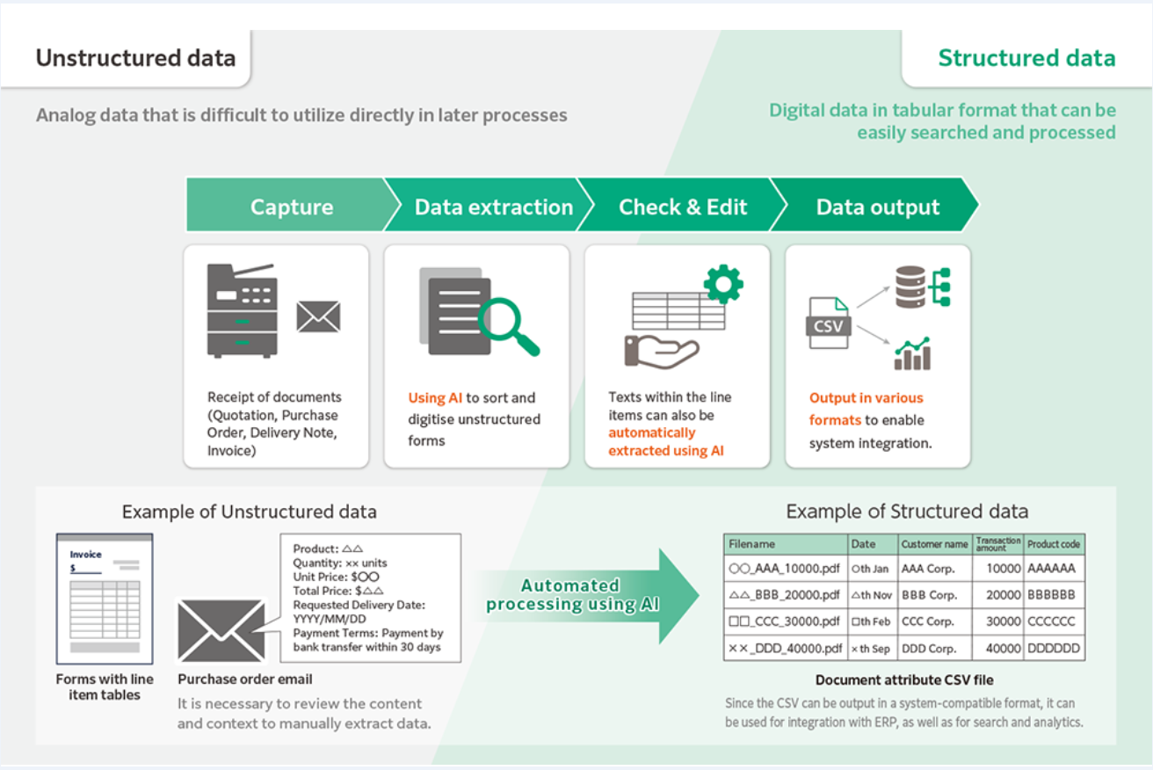
Answer
Yes, it does offer AI-enhanced solutions that specialize in processing, classifying, and extracting information from unstructured documents and images, which is a key aspect of unstructured data handling in many industries.

Slide 12
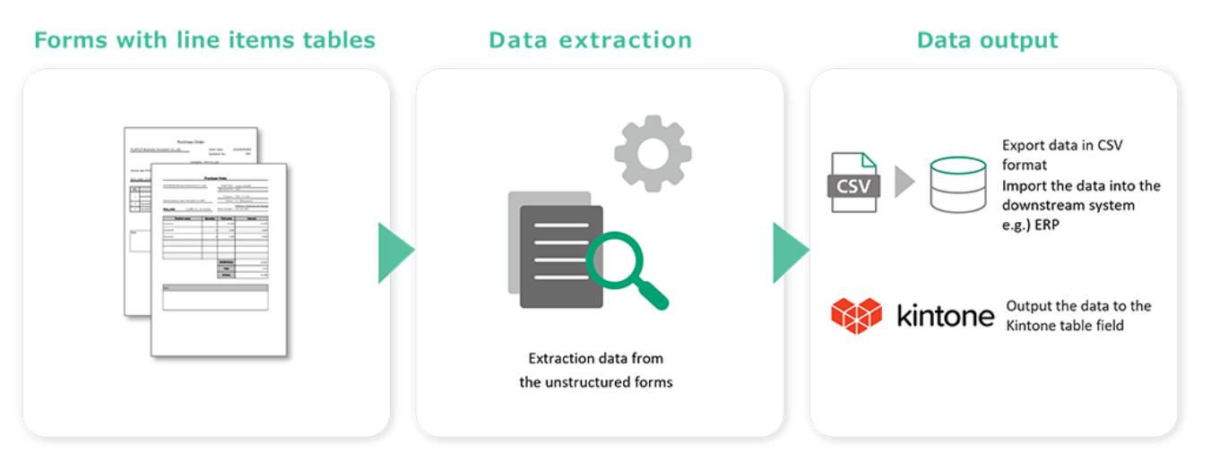
Answer
FUJIFILM Business Innovation has enabled robust reading of line-items tables in non-standard ledger sheets using OCR powered by generative AI.
FUJIFILM IWpro supports the full workflow
Automated data conversion for non-standard forms without prompt configuration. Generative AI-enhanced OCR convert estimates, purchase orders, delivery notes, and invoices - the formats vary by company - into structured digital data.
Direct integration with business workflow, Outputs structured data in formats compatible with subsequent systems, enabling direct import into sales or accounting systems without additional data processing or editing.

Slide 13
Question 3:
What is an AI Model and provide examples?
Type your answer in Meeting Chat

Slide 14
AI Model
An AI model is a computer program that has been trained to recognize patterns and make predictions or decisions based on data. Think of it as a mathematical representation of how to perform a specific task.
Here's a simple way to understand it:
The basics:
An AI model learns from examples (training data) rather than being explicitly programmed with rules
It contains parameters (numbers) that get adjusted during training to improve its performance
Once trained, it can make predictions or generate outputs for new, unseen inputs
Common examples:
Neural Networks used for image recognition models that can identify objects in photos
Language models (like me!) that can understand and generate text
Recommendation models that suggest movies or products you might like
Voice recognition models that convert speech to text

Slide 15
Large Language Model(LLM)
It's a type of AI model specifically designed to understand and generate human language (text).
Think of it as: An AI that learned to read, write, and understand language by studying millions of books, articles, websites, and conversations.
Traditional Computer Program | LLM
IF user asks "What's the weather?" THEN respond with weather data (Developer needs to program every possible response) | Read billions of examples of human conversations Learn patterns of how people communicate Generate responses based on those patterns (It learned from examples, not explicit programming) "Large" Trained on massive amounts of text data Has billions (or trillions) of parameters Like having read the entire internet multiple times "Language" Understands text/words Can work in multiple languages Grasps context, nuance, grammar "Model" A pattern-recognition system Predicts what words/text should come next Based on everything it learned during training

Slide 16
Question 4:
What are some popular Large Language Models (LLMs) by name?
Type your answer in Meeting Chat

Slide 17
Large Language Model(LLM) - Examples
The table below provides a comparison between Proprietary and Open-Source Large Language Models across key features and examples.
Model | Description | Access | Cost
GPT-4 (OpenAI) | Has general capability, strong reasoning, content creation, and code generation. | API-based | Usage-based pricing
Claude (Anthropic) | Focuses on helpfulness, safety, long context. | API-based | Usage-based pricing
Gemini (Google DeepMind) | Multimodal, highly integrated with Google products. Gemini enables powerful cross-domain AI experiences. | API-based | Usage-based pricing
Falcon | Scalable open models suited for a wide range of NLP tasks such as such as text classification, generation, and summarization. | Downloadable | Open source, compute cost applies
Mistral | Lightweight, fast models optimized for on-device or cloud use. | Downloadable | Open source, compute cost applies
LLaMA (Meta) | Strong performance with smaller model sizes. | Downloadable | Open source, compute cost applies

Slide 18
How LLMs are Trained?
The following outlines the process to train an LLM.
Feed it massive amounts of text
  Books, articles, websites, code, conversations
  Billions of examples of human writing
It learns patterns
  "After the word 'Hello', people often say names"
  "Questions usually start with Who/What/When/Where/Why/How"
  "Formal emails use 'Dear' and 'Sincerely'"
  "Code functions have specific syntax“
It predicts what comes next
  Given: "The capital of France is..."
  Predicts: "Paris" (because it saw this pattern thousands of times)
Simple Example:
Training data the LLM saw:
- "The sky is blue"
- "The ocean is blue"
- "Blue is a color"
Now you ask: "What color is the sky?"
LLM predicts: "blue" (pattern from training)

Slide 19
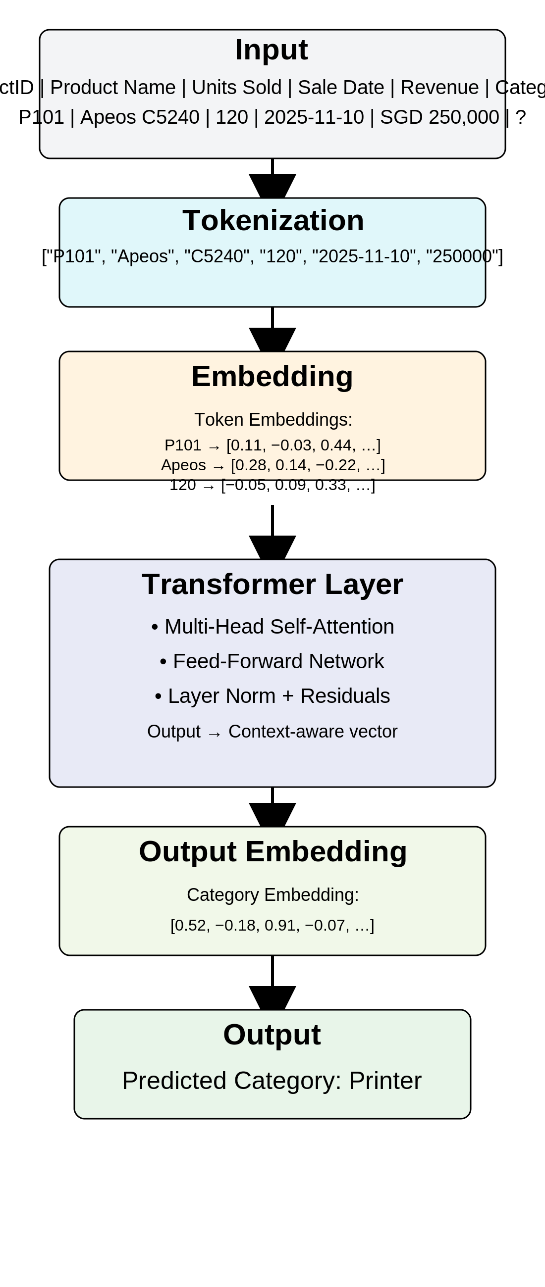
High Level Architecture of LLM’s
Large Language Models (LLMs) like GPT, BERT, and others are built upon the Transformer architecture, which fundamentally changed natural language processing by enabling efficient and accurate modelling of language.

Slide 20
High Level Architecture of LLM’s
Step | Description
1. Input Text | The phrase "The cat sat on the" is the starting input.
2. Tokenization | Breaks text into smaller pieces (tokens) - [The][cat][sat][on][the]
3. Embedding | Each token is converted into a numerical vector representing its meaning: "cat" might become [0.2, 0.8, 0.1, ...], these embeddings capture semantic information.
4. Positional Encoding | Transformers process all tokens simultaneously (in parallel), the model needs information about the order of words. Positional encodings are added to embeddings to indicate token positions (e.g., "cat" is the 2nd word). ( PE_{(pos, 2i)} = \sin\left(\frac{pos}{10000^{\frac{2i}{d}}}\right) ) ( PE_{(pos, 2i+1)} = \cos\left(\frac{pos}{10000^{\frac{2i}{d}}}\right) ) where ( pos ) is the position, ( i ) is the dimension index, and ( d ) is the model’s embedding size.
5. Transformer Blocks | Self-Attention Layer (Which words relate?) Determines which words in a sentence are most relevant to each other LLMs use multiple (8-96+ "heads"): Head 1: Focuses on subject-verb relationships, Head 2: Focuses on object relationships Head 3: Focuses on adjectives-nouns, Head 4: Focuses on temporal relationships Each head learns different patterns! All combined for rich understanding. Feed Forward Network (Process patterns) Processes the attention output through more layers
6. Output Layer | Predict next token probabilistically (e.g., "mat" 85%)
7. Output Text | "The cat sat on the mat"

Slide 21
Vector Databases
Specialized databases designed to store and search high-dimensional vectors, efficiently enabling similarity search on embeddings.
Traditional databases rely on exact matches (e.g., keywords). Vector databases allow searching by similarity (e.g., meaning, likeness).
Useful when "close enough" or contextual relevance matters.
Use cases: semantic search, recommendations, image similarity.
Example: When searching for similar documents or images, vector databases help quickly retrieve relevant results based on embedding similarity.

Slide 22
Demo
Let's go through the code demonstrating how the Transformer works with the Fujifilm dataset.
Presented below is sample data to demonstrate how the LLM processes information internally,
Review | Sentiment
Exceeded my expectations | positive
Great product | positive
Not worth the money | negative
Fine | neutral
Impressed | positive
Top-notch experience overall | positive
Disappointed | negative
Amazing speed and features | positive
Bad customer service | negative
Performance is terrible | negative
Highly recommend this item | positive
It's okay for the price | neutral
Just a basic product | neutral
Average product performance | neutral
Neither good nor bad | neutral
Engineer attitude is good | positive
Engineer attitude is not good | positive
Engineer could not explain about problem | positive
CSE is on time | positive
Don't send the same Engineer again | negative
Can't wait anymore | negative

Slide 23
Question 5:
What does GPT stand for?
Type your answer in Meeting Chat

Slide 24
Answer
Explanation:
GPT stands for Generative Pre-trained Transformer:
Generative: GPT can produce (generate) text, completing sentences, answering questions, translating languages, and even creating creative content like stories or poems.
Pre-trained: Before you use GPT, it is trained on a huge dataset of text from books, articles, websites, and more. This pre-training helps it understand language patterns and context.
Transformer: This refers to the specific neural network architecture GPT uses. Transformers excel at processing sequential data, like sentences, and capturing relationships between words.

Slide 25
Question 6:
How many tokens does this sentence contain?
Fujifilm printer status is active
Type your answer in Meeting Chat

Slide 26
Answer
Explanation:
"Fujifilm printer status is active"
Contains 5 tokens when tokenized by most common tokenizers used in LLM’s like OpenAI’s GPT.
"Fujifilm"
"printer"
"status"
"is"
"active“
Each word here corresponds to one token because they are common words without punctuation or compound forms.
# Choose encoding - use "gpt2" encoding for GPT-3/GPT-4 models
encoding = tiktoken.get_encoding("gpt2")
sentence = "Fujifilm printer status is active"
tokens = encoding.encode(sentence)
Tokens: [10938, 17894, 3626, 318, 437]
Number of tokens: 5

Slide 27
Introduction to Prompts
Definition:
A prompt is the input or instruction given to an AI model to generate a response.
Purpose:
Guides the model to produce relevant and meaningful output.
Why are Prompts Important?
Good prompts lead to better answers and clearer communication.
Types of prompts:
Questions
Statements
Commands
Context + request
Examples + instructions
Any kind of text that guides the AI on what kind of output you want.

Slide 28
Types of Prompts and Examples
a) Questions
Used to request information or clarification. Usually end with a question mark (?)
Examples: "What is the warranty period for Fujifilm printers?"
"How do I set up Wi-Fi on my Fujifilm printer?“
b) Statements
Used to provide information or facts. Typically, declarative sentences.
Examples: "Fujifilm printers support duplex printing as a standard feature."
"The ApeosPort series is suitable for medium to large offices.“
c) Commands
Instructions telling what action to perform. Often start with a verb.
Examples: "Print 20 copies of this report."
"Scan the document and email it to the HR department.“
d) Context + Request
Provides background information to clarify a request or question.
Examples: "Our office prints about 500 pages daily. Can you suggest a Fujifilm printer model that fits this volume?"
"We need secure printing capabilities because we handle confidential documents. What options does Fujifilm offer?"

Slide 29
Comparison Between SQL Query Output and AI Prompt Response
Below is a comprehensive example including SQL join query across multiple tables with the requested fields and Output– Generate a report with list of Machines in Field(MIF)
SELECT c.CompanyName, p.Model AS PrinterModel, p.SerialNumber, p.InstalledDate, p.Status AS MachineStatus, ctr.ContractType, mr1.MeterValue AS M1_Value, mr2.MeterValue AS M2_Value,
mr3.MeterValue AS M3_Value, c.PreferredEngineer
FROM Customers c
JOIN Printers p ON c.CustomerID = p.CustomerID
LEFT JOIN Contracts ctr ON p.PrinterID = ctr.PrinterID
LEFT JOIN MeterReadings mr1 ON p.PrinterID = mr1.PrinterID AND mr1.MeterType = 'M1'
LEFT JOIN MeterReadings mr2 ON p.PrinterID = mr2.PrinterID AND mr2.MeterType = 'M2’
LEFT JOIN MeterReadings mr3 ON p.PrinterID = mr3.PrinterID AND mr3.MeterType = 'M3'
WHERE p.Status = 'Active’;
Output:
Company Name | Model | Serial Number | Installed Date | MIF Status | Contract Type | M1_Value | M2_Value | M3_Value | Preferred Engineer
Acme Corp | ApeosPort C4570 | SN123456789 | 2022-01-15 | Active | Full Service | 12000 | 8000 | 2000 | John Doe
Beta Solutions | ApeosPort C3570 | SN987654321 | 2021-11-20 | Active | Maintenance | 15000 | 11000 | 3500 | Jane Smith

Slide 30
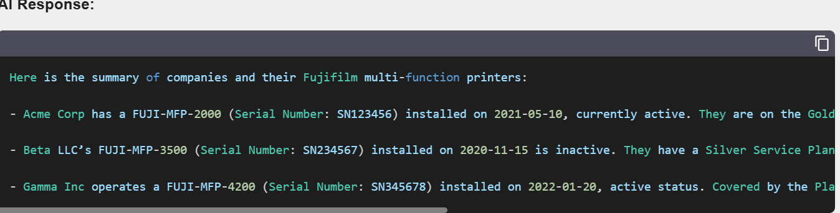
Comparison between SQL and AI prompt
Below is the AI-generated response based on the prompt.
“Show me the details of all active Fujifilm multifunction printers including company name, printer model, serial number, installation date, machine status, contract type, last meter readings for M1, M2, M3, and the preferred engineer for each customer”
Outputs:

Slide 31
What is Prompt Engineering?
Definition:
Prompt engineering is the practice of designing and refining inputs to get the best possible outputs from AI language models. Think of it as learning to communicate effectively with a highly capable but literal assistant.
Importance:
- Better Results: Well-crafted prompts produce more accurate, relevant, and useful responses
- Efficiency: Good prompts save time by reducing back-and-forth iterations
- Consistency: Structured prompts help achieve reliable outputs across similar tasks
- Cost Savings: Fewer tokens used means lower API costs for those using paid services

Slide 32
The 5-Part Prompt Template
To craft effective prompts for Large Language Models (LLMs), we can structure our prompt into five distinct parts:
1. ROLE: Who is the AI acting as?
2. CONTEXT: What's the situation/background?
3. TASK: What specific action do you need?
4. FORMAT: How should it be structured?
5. CONSTRAINTS: Length, tone, what to include/avoid
Example: Fujifilm Apeos C325 Printer Setup Guide
[ROLE]: You are a technical writer for office equipment
[CONTEXT]: New project manager needs to set up the Apeos C325 multifunction printer for a 15-person team. Common issue: connecting to network and enabling scan-to-email.
[TASK]: Create a quick setup checklist
[FORMAT]: 8 numbered steps, with one troubleshooting tip
[CONSTRAINTS]: Under 200 words, non-technical language, mention wireless and mobile printing capabilities

Slide 33
Prompt Engineering Techniques
Below table highlights several prompt engineering techniques with examples focused on Fujifilm products.
By understanding and applying the right technique, is crucial to crafting effective prompts and getting better results from language models.
Technique | Explanation of Technique | Prompt | Expected Output
Zero-shot | The model is given a direct instruction without examples. It relies on its pre-trained knowledge to answer. | List three common maintenance tasks for a Fujifilm Apeos multi-function printer | -Replacing toner cartridges. -Cleaning the scanner glass and rollers. -Checking and clearing paper jams.
Single-shot | The model is given one example demonstrating the task. The example helps guide the model on how to perform the task before it is asked to generate a response for a new input. | "Here is an example of a maintenance task for a Fujifilm printer: Example: Replace the toner cartridge when the print quality deteriorates. Now, list three common maintenance tasks for a Fujifilm Apeos multi-function printer." | -Replace the toner cartridge when print quality decreases, -Clean the scanner glass and rollers regularly. -Remove and clear any paper jams promptly.
Few-shot | Provides examples (Q&A pairs) to guide the model on the expected format and type of answer before asking. | Q: What is the battery life of the Fujifilm X100V? A: Approximately 350 shots per charge. Q: What is the ISO range of the Fujifilm X-T3? A: | ISO 160 to 12800, expandable to 80-51200.

Slide 34
Prompt Engineering Techniques
Technique | Explanation of Technique | Prompt | Expected Output
Role prompting | Sets a persona (“sales expert”) to influence tone, style, and content suited for selling the product. | You are a sales expert. Explain why a beginner photographer should consider buying the Fujifilm Instax Mini 11. | The Fujifilm Instax Mini 11 is perfect for beginners because it’s easy to use with auto exposure, offers instant photo prints, and comes in fun pastel colors, making photography accessible and enjoyable.
Chain-of-thought | Encourages the model to break down its answer into logical sequential steps, useful for procedural tasks. | Explain step-by-step how to change the film in a Fujifilm Instax Mini camera. | First, open the back cover by pressing the latch. Next, remove the used film cartridge carefully. Then, insert a new film pack aligning it properly. Finally, close the cover and the camera is ready to shoot.
Instruction + format | Provides clear instructions and specifies a desired output format (bullet list) for organized, readable answer. | List three popular Fujifilm lens models with their focal lengths in bullet points. | Fujifilm XF 35mm f/1.4 R: 35mm prime lens Fujifilm XF 16-55mm f/2.8 R LM WR: Standard zoom lens Fujifilm XF 56mm f/1.2 R: Portrait prime lens
Few-shot + Role | Combines few-shot examples with role prompting to guide both content | You are a knowledgeable technical support specialist for Fujifilm printers. Examples: | To connect your Fujifilm printer to Wi-Fi, go to the printer’s menu, select Network Settings, choose your Wi-Fi network, and enter the password to establish a connection.

Slide 35
Question 7:
Is the following sentence a prompt? If yes, which prompt engineering technique is being used?
“Show me the details of all active Fujifilm multifunction printers including company name, printer model, serial number, installation date, machine status, contract type, last meter readings for M1, M2, M3, and the preferred engineer for each customer”
Type your answer in Meeting Chat

Slide 36
Answer
It’s an example of a Zero-Shot Prompt because:
It directly asks the model to perform a task or provide information.
It does not include any examples or demonstrations beforehand.
It expects the model to generate the correct response based solely on its training and understanding of the query.

Slide 37
Key Configuration Parameters in Large Language Models (LLMs)
When working with large language models like GPT, it’s important to understand the key parameters that control how the model generates text. These parameters help us customize the output to suit different applications—whether you want precise answers or creative writings.
Parameter | Description | Typical Range / Values
Temperature | Controls randomness in output. Lower values make output more deterministic; higher values increase creativity. To adjust the creativity level of the AI’s responses based on desired behaviour. | 0.0 (deterministic) to 1.0 (creative and varied outputs); often 0.7
Max Tokens | Sets the maximum number of tokens (which can be words or parts of words) that the AI model is allowed to generate in its response. | Typically, from a few up to model max (~4,000+ tokens)
Top-p (Nucleus Sampling) | Limits token selection to a subset with cumulative probability p, balancing randomness and focus. | 0.0 to 1.0 (e.g., 0.9 for balanced output)
Top-k | Restricts sampling to top-k most probable tokens for the next step. | Integer values, e.g., 40 or 50
Stop Sequences | This is a specific sequence of characters (words, punctuation, or phrases) that signals the AI to stop generating further text when encountered in the output. | Custom strings or characters, e.g., "\n", "###"
Frequency Penalty | Penalizes repeated tokens to reduce repetition in the response. | 0.0 to 2.0
Presence Penalty | Penalizes tokens that have appeared to encourage introduction of new topics. | 0.0 to 2.0
Best_of | Generates multiple completions server-side and returns the best one based on likelihood. | Integer, e.g., 1 to 5 (can increase latency/cost)
Logprobs | Returns the log probabilities of generated tokens for analysis/debugging. | Integer number of tokens to return logprobs for

Slide 38
Large Language Model (LLM) APIs
Large Language Model (LLM) APIs are application programming interfaces that allow developers to interact with powerful language models like GPT (Generative Pre-trained Transformer), enabling applications to perform natural language understanding and generation tasks.
These APIs provide programmatic access to functionalities such as text generation, text completion, summarization, translation, question answering, sentiment analysis, and more, without the need for developers to train or host the models themselves.
Examples of popular LLM APIs:
OpenAI GPT API: Provides access to GPT-3, GPT-4 models for chat, completion, embeddings, etc.
Google PaLM API: Offers advanced language understanding and generation.
Anthropic Claude API: Focuses on safe and steerable AI assistants.
Cohere API: Provides generation, classification, and embedding models focused on business use.

Slide 39
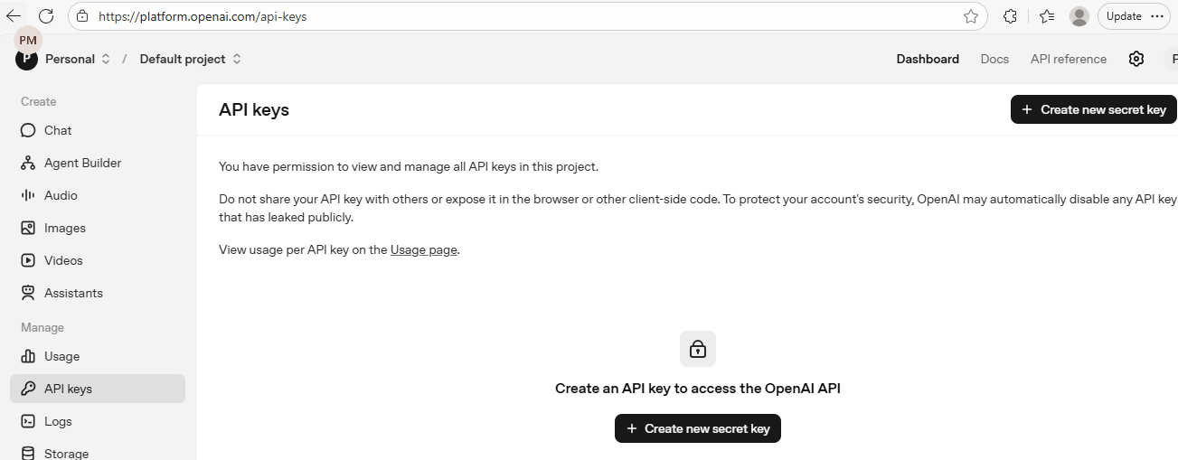
How to Access LLM Using Open AI API?
The OpenAI API lets applications send text, images, or other inputs to OpenAI models and receive model‑generated outputs over HTTPS, just like calling any other web service.
Get an API Key
  Sign up or log in at OpenAI’s platform.
  Navigate to API keys and create a new API key.
  Keep this key secure as it allows access to the service
Demo on how to setup API key.

Slide 40
Demo on how to call API
Here's a clean and concise demo on how to call the OpenAI API
from openai import OpenAI
#API_KEY = "" # Put your real key here
# Configure the API client
#client = OpenAI(api_key=API_KEY)
client = OpenAI(api_key = "sk-”

Slide 41
Demo on Configuration parameters and Techniques
Here's a clean and concise demo on Understanding Generation Configuration parameters.
def display_default_config():
print("📋 Default ChatGPT Generation Configuration")
print(“*" * 50)
config_dict = {
"temperature": 1.0, # default value
"top_p": 1.0, # default nucleus sampling
"max_output_tokens": "Model-dependent (can vary by model)",
"presence_penalty": 0.0,
"frequency_penalty": 0.0,
"stop": None # no stop sequence by default }
# Print config values
for param, value in config_dict.items():
print(f" {param}: {value}")

Slide 42
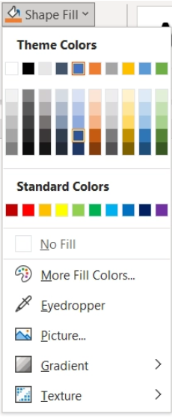
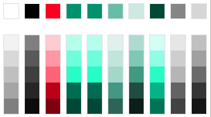


Color Palette Guide
**************************************
Please delete this page and the color palette placed on the left end of pp. 3-6 when creation of the presentation slide is completed **************************************
Please follow the procedures below to select colors.
(1) In principle, please use the “Primary Colors”
to create presentation slides.
Color Picker Palette
The six colors displayed here under “Theme colors” are Fujifilm’s primary colors, consisted of 4 gradations of Advanced Green and 2 gradations of Innovative Gray.
Please use the four colors on the left side of the Theme Colors (white, black, Communication Red, and Advanced Green) for texts.
Primary Colors
Secondary Colors
Please avoid using colors automatically displayed here, which are different from Fujifilm brand’s color palette.
(2) If the use of colors other than the
“Primary Colors” is necessary to classify
or identify data, you may select colors
from the “Secondary Colors”.
-Select an object and click the “Eyedropper” from the
“Shape Fill” drop-down menu.
-Place the eyedropper on the color picker palette and
click to choose your favorite secondary color.
*Please note that the “Eyedropper” tool is available only when you open the
PowerPoint application, and not when it is open via web browser.
100%
80%
60%
40%
20%
10%
+K60%

Slide 43
Title 20pt
Primary Colors
Secondary Colors
First Level Text, Arial 16pt, no bullet
  Second Level Text, Arial 14pt, bulleted
    Third Level Text, Arial 12pt, bulleted
      Fourth Level Text, Arial 12pt, bulleted
        Fifth Level Text, Arial 12pt, bulleted
First Level Text, Arial 16pt, no bullet
  Second Level Text, Arial 14pt, bulleted
    Third Level Text, Arial 12pt, bulleted
      Fourth Level Text, Arial 12pt, bulleted
        Fifth Level Text, Arial 12pt, bulleted
100%
80%
60%
40%
20%
10%
+K60%

Slide 44
Title 20pt
Primary Colors
Secondary Colors
100%
80%
60%
40%
20%
10%
+K60%

